Slide 1

Machine Learning-Based​
Earthquake Magnitude​
Prediction​
Team-6

Slide 2

Introduction​
Earthquakes are destructive natural disasters.​This project uses machine learning to predict​ earthquake magnitude from historical seismic​ data.​

Slide 3

Problem Statement​
Traditional statistical methods struggle with​ complex and nonlinear seismic patterns.​Accurate magnitude prediction can support​ preparedness and risk mitigation by SMS.​

Slide 4

Objectives​
Predict earthquake magnitude​
Analyze historical seismic data​
Compare ML algorithms​
Improve disaster preparedness​

Slide 5

Dataset​
Sources:​
USGS Earthquake Catalog​
Kaggle Earthquake Database​
IRIS Seismic Data​
NOAA Earthquake Database​
Global Earthquake Model (GEM)​

Slide 6

Input Features​
The Machine Learning model uses important earthquake parameters:
Latitude: Location of earthquake occurrence.
Longitude: Geographic position of the earthquake.
Depth: Distance below Earth's surface where the earthquake starts.
Time: Date and time information of seismic activity.
Seismic Measurements: Recorded earthquake-related values.

Slide 7

Modern Tools & Technologies
Python – Core development language
TensorFlow / Scikit-learn – Earthquake prediction and analysis
Pandas & NumPy – Data preprocessing and analytics
IoT Seismic Sensors – Real-time earthquake detection
GPS/GIS – Location tracking and affected-area mapping
Twilio SMS API – Instant warning message delivery
MySQL/Firebase – Data storage and user management
Streamlit – Monitoring dashboard
Google Colab – Model development and testing
AWS/GCP Cloud – Real-time processing and scalability

Slide 8

Machine Learning Models
Linear Regression:
Finds a simple relationship between input features and magnitude.
Decision Tree Regressor:
Uses decision rules to make predictions.
Random Forest Regressor:
Combines multiple decision trees for better accuracy.
XGBoost:
A powerful boosting algorithm that improves prediction performance.
Artificial Neural Network (ANN):
Learns complex patterns similar to the human brain.

Slide 9

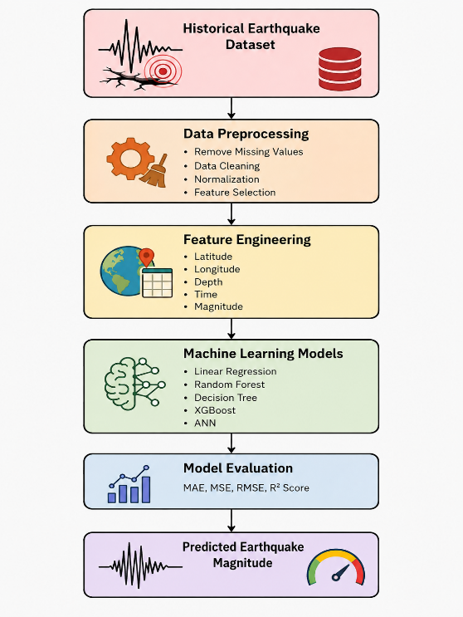
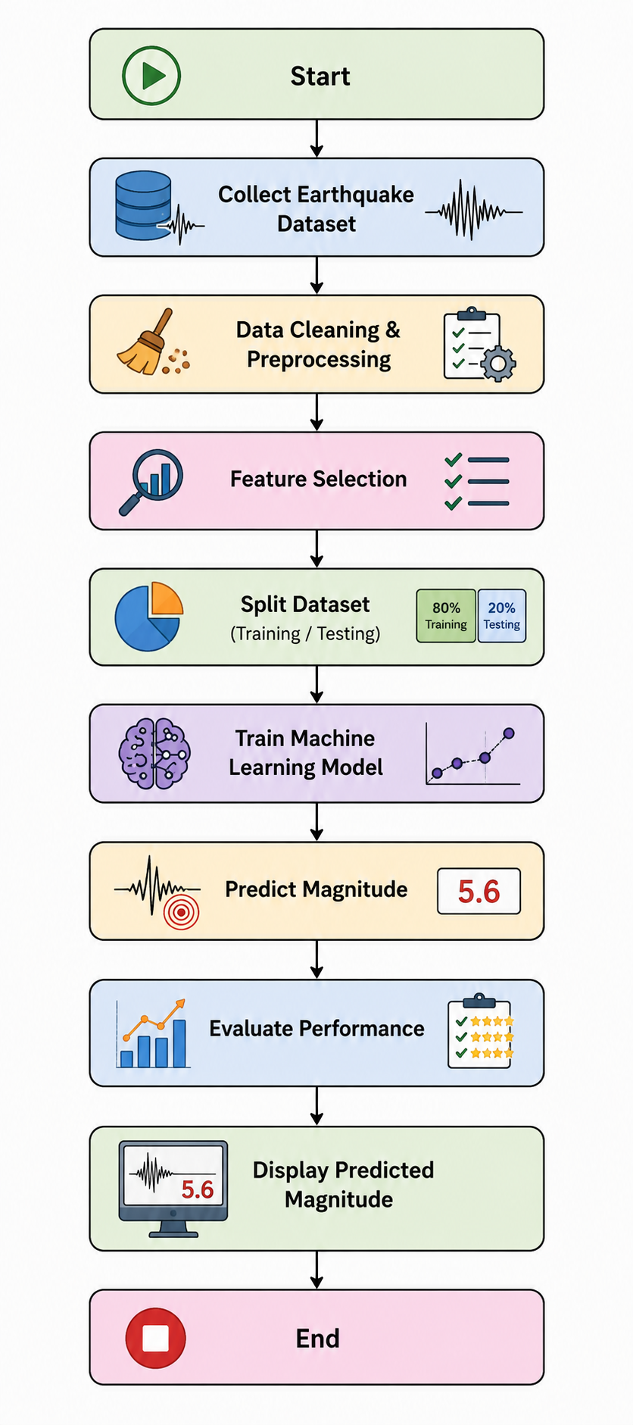
Approach
Flow Chart

Slide 10






Evaluation Metrics
Mean Absolute Error (MAE):
Measures average prediction error.
Mean Squared Error (MSE):
Calculates the average squared difference between actual and predicted values.
Root Mean Squared Error (RMSE):
Shows prediction accuracy with the same unit as magnitude.
R² Score:
Indicates how well the model explains earthquake magnitude variations.

Slide 11
No. | Research Paper Title | Model / Algorithm | Dataset Used | Key Outcome | Limitations
1 | Recent Advances in Early Earthquake Magnitude Estimation by Using Machine Learning Algorithms: A Systematic Review | SVM, CNN, CNN-LSTM, XGBoost, RF, LSTM | K-NET, KiK-net, STEAD, IPOC and others | Shows that ML/DL models can estimate earthquake magnitude effectively; compares many existing approaches. (MDPI) | Performance varies strongly with dataset, region and input waveform quality.
2 | A machine learning framework with parameter optimization and regional clustering for strong earthquake prediction | Random Forest | Japan and New Zealand earthquake catalogs | Uses regional clustering and 16 seismic activity indicators; RF is used for strong-earthquake prediction. (Springer) | Requires carefully engineered seismic indicators and regional clustering; results may not directly generalize to other regions.
3 | Climatic and seismic data-driven deep learning model for earthquake magnitude prediction | Deep Neural Network / Deep Learning | Indonesia, Japan and HKKH-region earthquake datasets | Combines climatic and seismic information to improve earthquake magnitude prediction. (Frontiers) | Dependence on additional climatic variables increases data requirements and model complexity.
4 | Scalable earthquake magnitude prediction using spatio-temporal data and model versioning | LightGBM, XGBoost, Gradient Boosting, Random Forest, Linear Regression | Spatio-temporal earthquake dataset | LightGBM performed best on the larger dataset; the MLOps pipeline supports model tracking and deployment. (Nature) | Performance depends on dataset size and feature quality; the study reports moderate R² rather than near-perfect prediction. (PubMed Central (PMC))
5 | Earthquake Prediction Using Machine Learning: Improved Magnitude Estimation with LSTM over Random Forest | Random Forest + LSTM | Historical earthquake parameters: latitude, longitude, depth and magnitude | LSTM addresses RF's weakness in sequential/time-series magnitude prediction. (Zenodo) | LSTM requires sequential data preparation and greater computational complexity than conventional ML.

Slide 12
No. | Research Paper Title | Model / Algorithm | Dataset Used | Key Outcome | Limitations
6 | Comparative Analysis of Decision Tree, Random Forest, SVM, and Neural Network Models for Predicting Earthquake Magnitude | Decision Tree, Random Forest, SVM, Neural Network | USGS earthquake dataset | Compares four ML models using MAE, RMSE and R² to identify a suitable magnitude prediction model. | Results are based on the selected USGS dataset and may vary for other geographical regions.
7 | Application of Machine Learning Models to Multi-Parameter Maximum Magnitude Prediction | Random Forest, LSTM and other ML models | Earthquake catalog from southern China’s North–South Seismic Belt | Uses 11 seismicity indicators and compares six ML models; LSTM was selected as the best-performing model for the study. | Regional study focused on southern China; prediction depends on the selected seismicity indicators.
8 | Machine Learning Applications for Earthquake Magnitude Prediction in Western Turkey | LSTM, CNN, ANFIS, Random Forest, Decision Tree | Western Turkey earthquake dataset | Compares five ML/DL approaches for weekly average magnitude prediction using RMSE, MSE, MAE and MAPE. | Focuses on a particular geographic region and weekly average magnitude rather than individual earthquake-event prediction.
9 | Deep learning model for predicting earthquake magnitude using bidirectional LSTM with attention mechanism on historical seismic data from 2017 to 2025 | Bi-LSTM + Attention | 2,000 earthquake records from Mediterranean, Southern Europe, North Africa and Western Asia | Achieved reported R² of 0.9837 and 90.82% accuracy within ±0.3 magnitude tolerance. | Dataset is relatively limited to 2,000 records and the study focuses on earthquakes above magnitude 4.9.
10 | Forecasting earthquakes by Machine Learning techniques: lights and shadows | Logistic Regression, Random Forest, XGBoost, LSTM | Southern California Earthquake Data Center (SCEDC) catalog | Evaluates multiple ML approaches and reports Random Forest as the strongest model in the study. | Results are based on Southern California data; transferability to different tectonic regions requires further validation.

Slide 13
No. | Identified Limitation / Research Gap | How Our Project Addresses It
1 | Many existing studies are region-specific, so their models may not generalize well to other geographical areas. | Use a larger and geographically diverse earthquake dataset to improve generalization.
2 | Some studies depend on complex seismic waveform data, which may not be easily available. | Use commonly available features such as latitude, longitude, depth, time, and seismic measurements.
3 | Deep learning models such as LSTM and Bi-LSTM can require large datasets and high computational resources. | Compare both traditional ML and advanced models and select the model that provides a good balance between accuracy and computational cost.
4 | Several studies focus on only one machine learning algorithm or a limited number of models. | Compare Linear Regression, Decision Tree, Random Forest, XGBoost, and ANN.
5 | Prediction performance differs depending on the quality and preprocessing of earthquake data. | Perform data cleaning, missing-value handling, feature selection, and normalization before training.

Slide 14

Expected Outcomes
Develop a model capable of predicting earthquake magnitude accurately.
Identify the best-performing machine learning algorithm.
Help researchers understand earthquake patterns.
Support disaster management authorities in planning and preparedness.

Slide 15
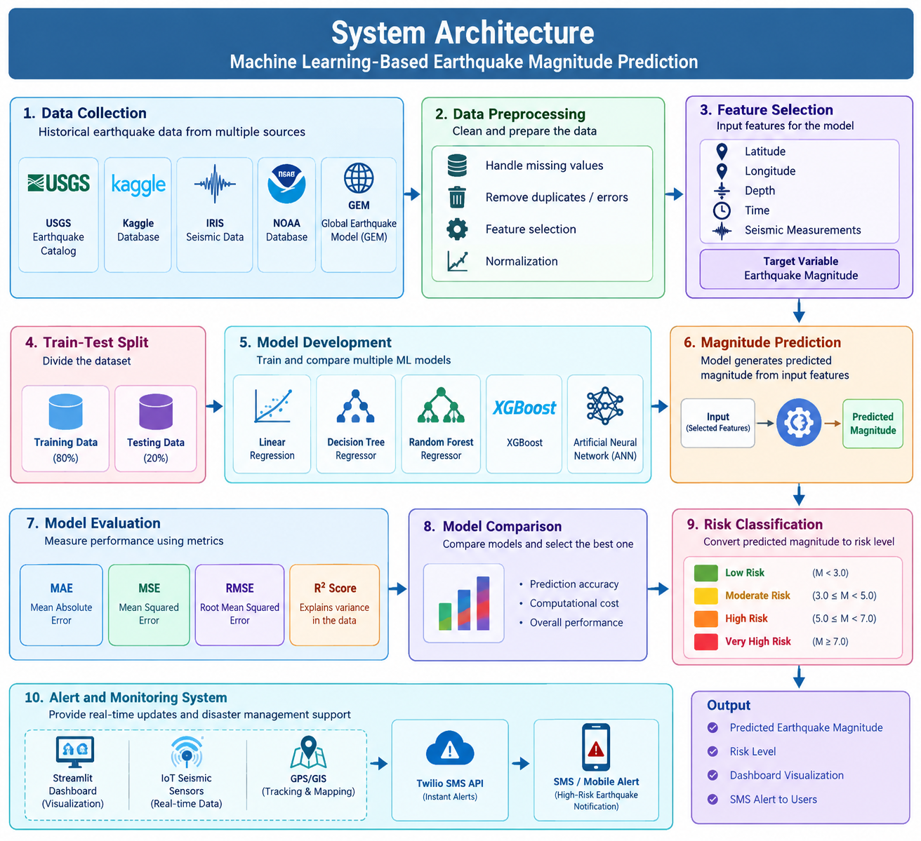


Slide 16

Project Team
Rahul (2420090043)
Sai Sujith (2420030280)
Nikhileash (2420030596)
Sumanth Reddy (2420030782)

